Slide 1
Week 9
Sprocs, Triggers, Rules, Defaults

Slide 2
SPROCs (Stored Procedures)
Syntax:
Think of these as pre-prepped selects that you don’t have to save in a file and cut and paste, or launch from .sql file (right click open with…)
They execute directly from SSMS.
Create PROC name
as
begin
select lastName
from nurse
where lastname like 'S%'
end;

Slide 3
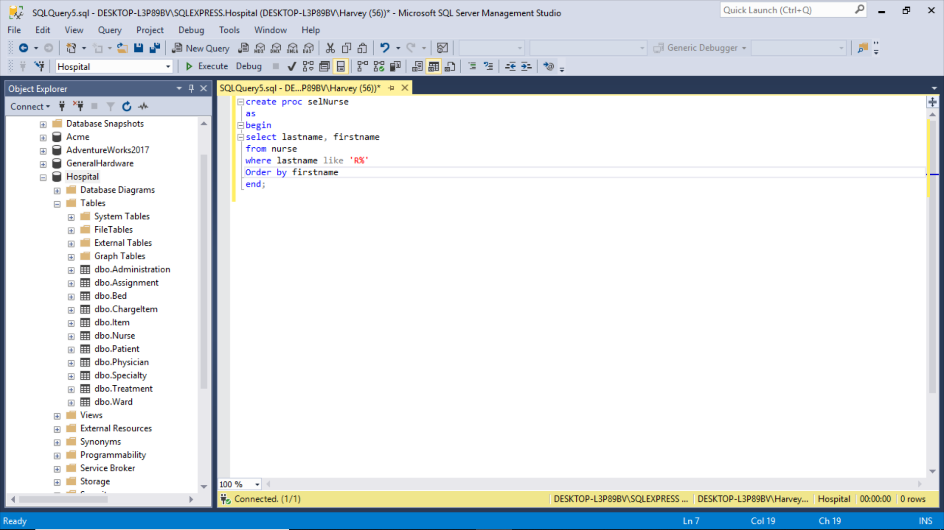

Slide 4
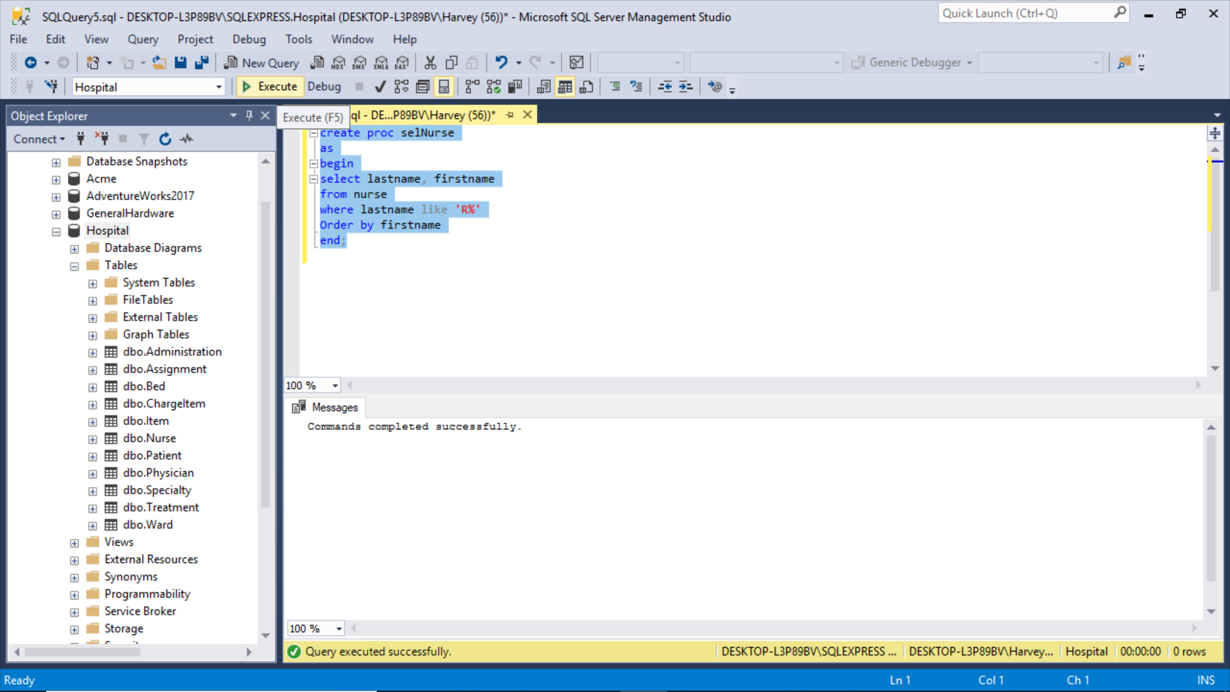

Slide 5
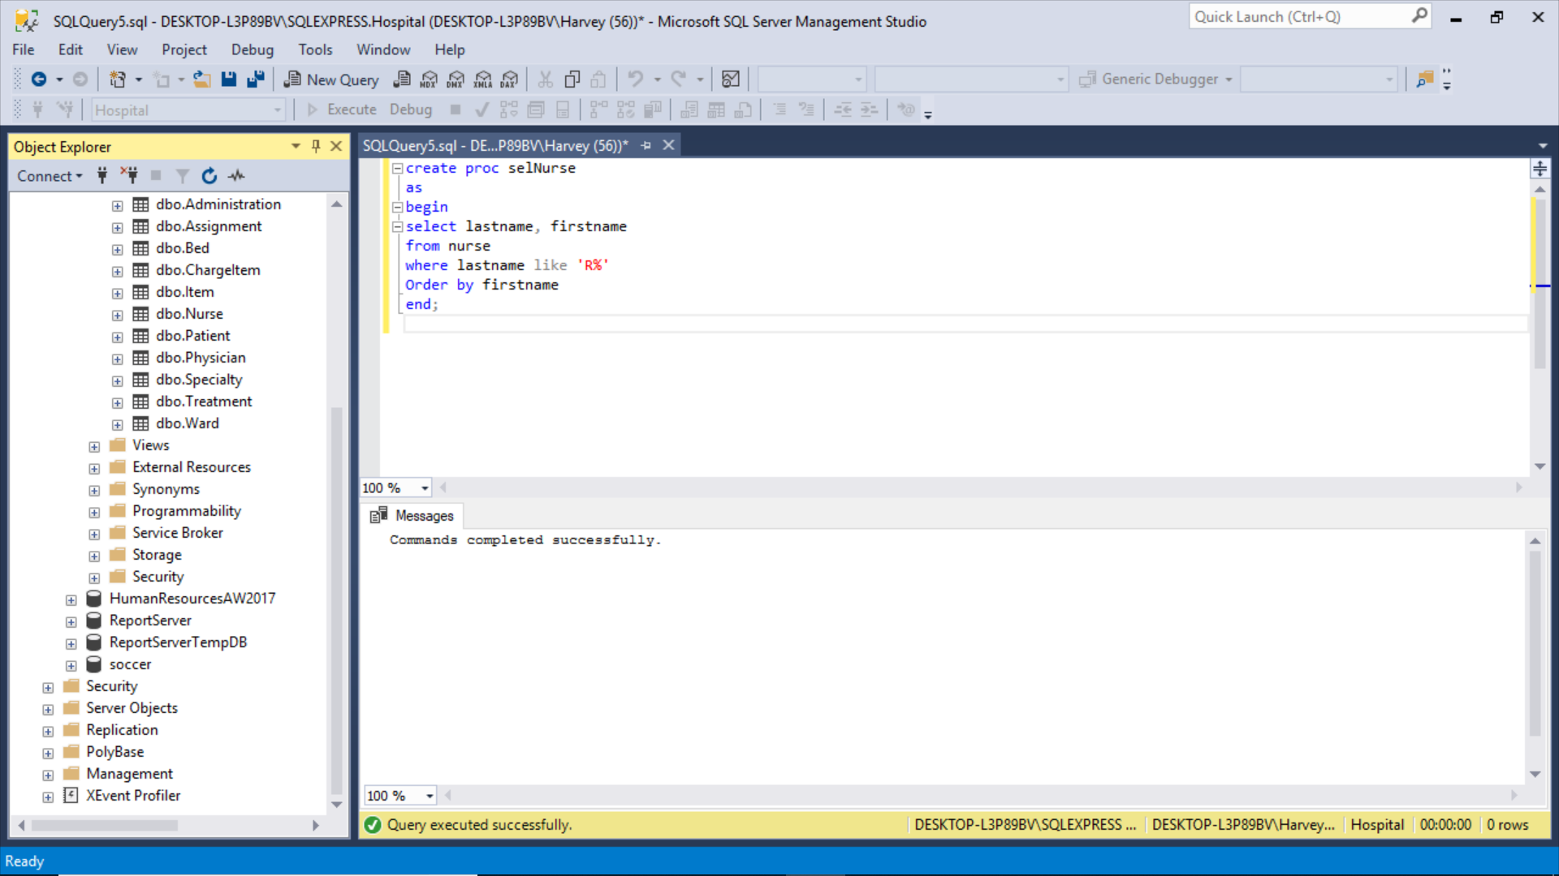

Slide 6
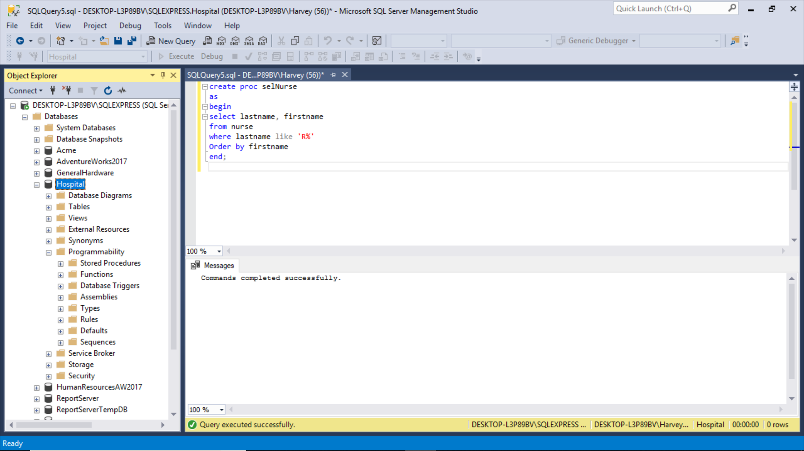

Slide 7

Right clicks rule the world

Slide 8
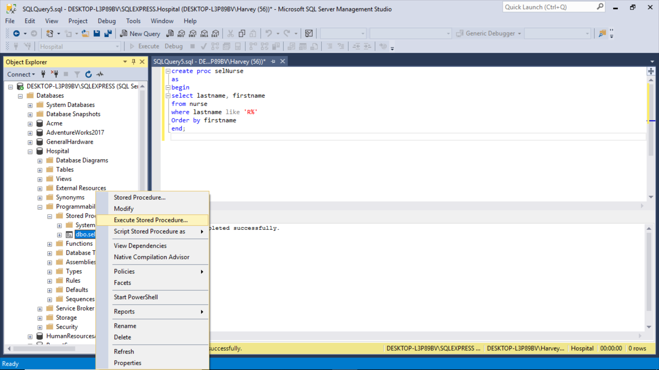

Slide 9
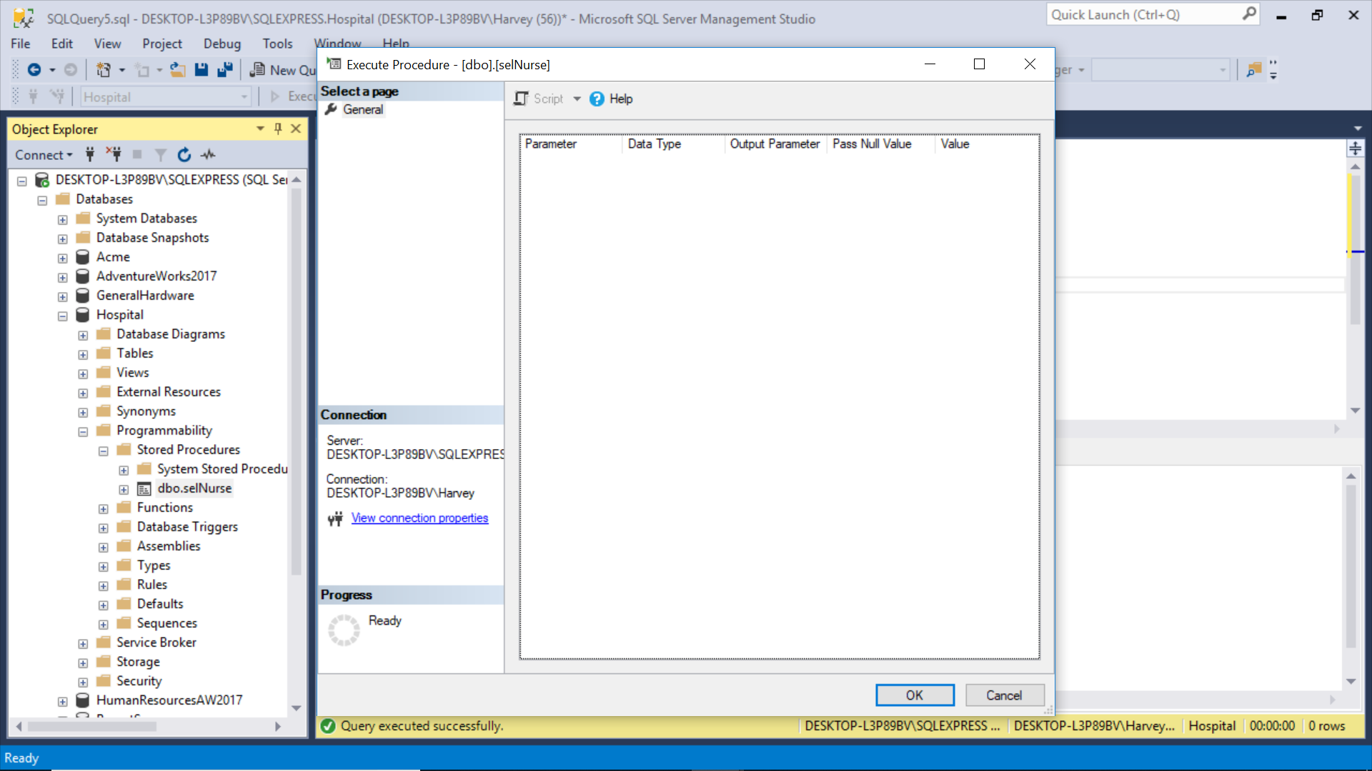

Slide 10
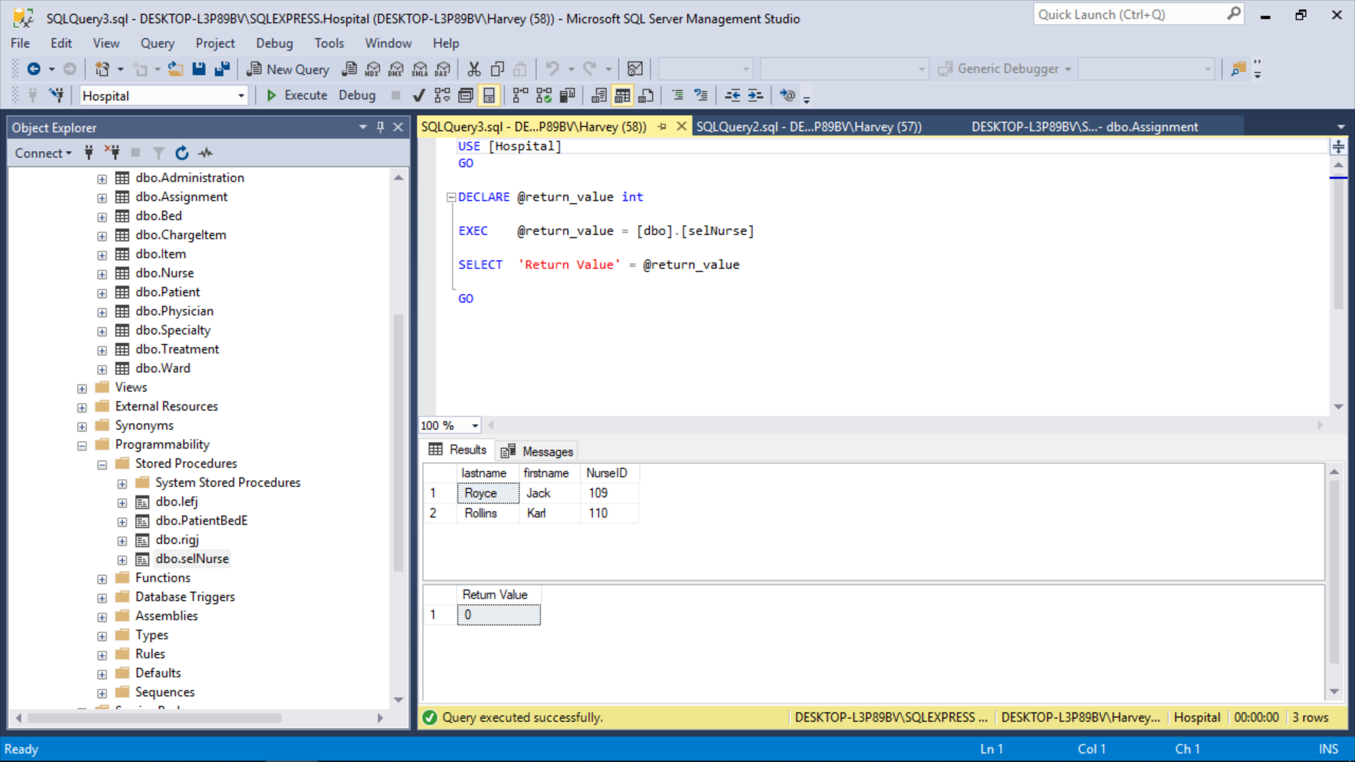

Slide 11
Constraints (CN)
Constraints are parameters used to design your database.
They are made up of: Triggers, Rules, Defaults, Checks (CK)
They work like SPROCs insofar as you save them and execute them.
You do not execute them. The system handles these constraints internally
Rules and Defaults are a special kind of CN in that they are “bound” to specific columns, or bound to a user defined data type;
they can also be unbound,
and used for multiple bindings to columns on different tables.

Slide 12
Adding Parameters to SPROCs
Think of this as using variables to dial in your query:
CREATE PROCEDURE SelectAllCustomers AS SELECT * FROM Customers GO;
EXEC SelectAllCustomers;
CREATE PROCEDURE SelectAllCustomers @City nvarchar(30), @PostalCode nvarchar(10) AS SELECT * FROM Customers WHERE City = @City AND PostalCode = @PostalCode GO;
EXEC SelectAllCustomers City = "London", PostalCode = "WA1 1DP";

Slide 13
Triggers (“fire” like a SPROC exec)
DDL (server or database level)
Events: Create, Alter, Drop
ON [database , server]
DML (table level)
Events: Insert, Update, Delete
ON [tablename]
Types of DML Triggers
For/After (fires an action after event)
Instead of (prevent or divert change)

Slide 14
Triggers
An automated system action you create as a stored procedure.
Syntax:
CREATE TRIGGER ddl_create_database
ON ALL SERVER
FOR CREATE_DATABASE
AS
PRINT 'Database Created.'
Naming Convention
Level
Firing Event
Action

Slide 15
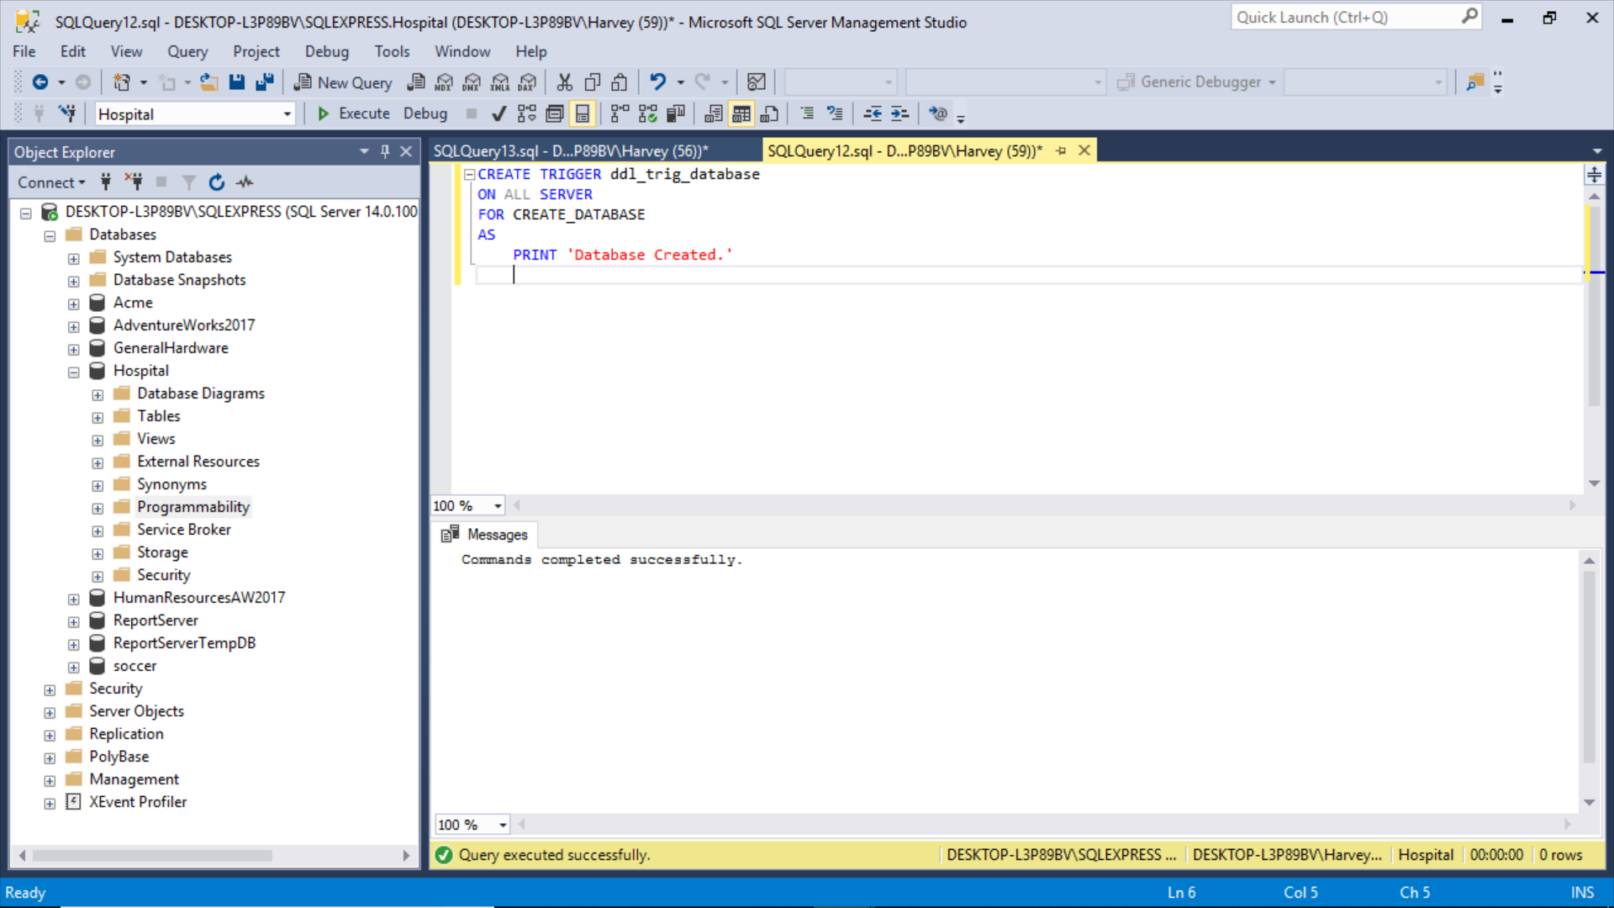

Slide 16
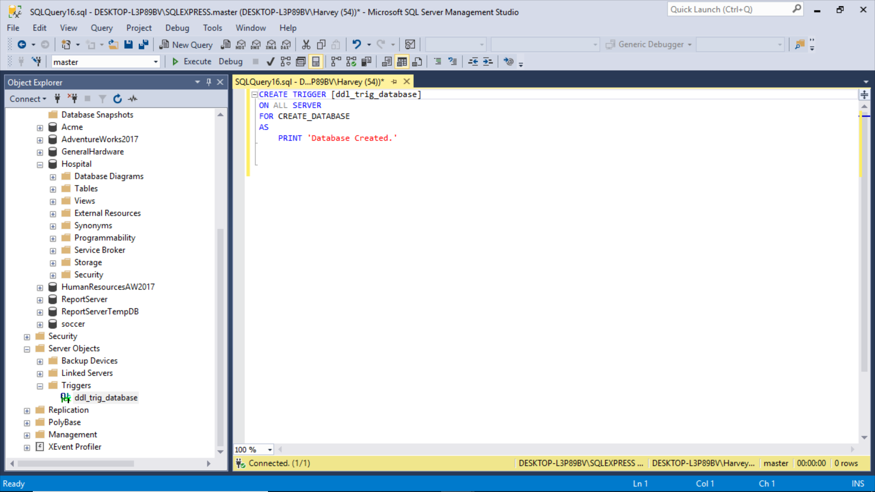
Server level trigger

Slide 17
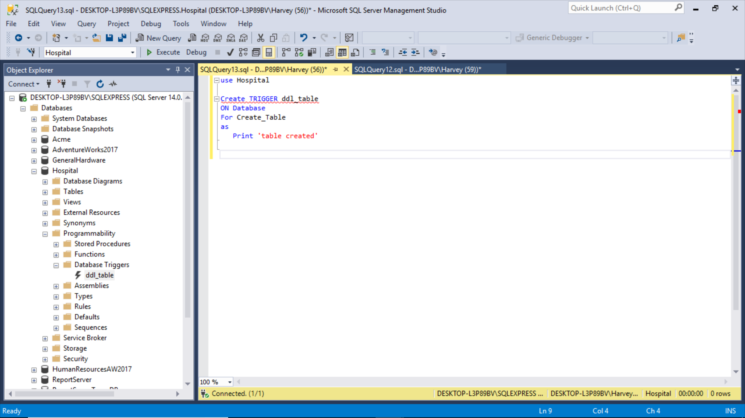
Database level trigger

Slide 18
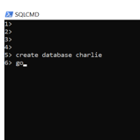
Let’s try it out (server level trigger – create database)

Slide 19
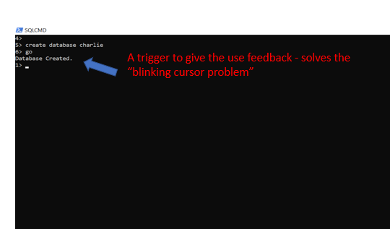

Slide 20
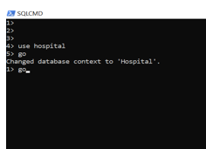
Now try database level Trigger (create table)

Slide 21
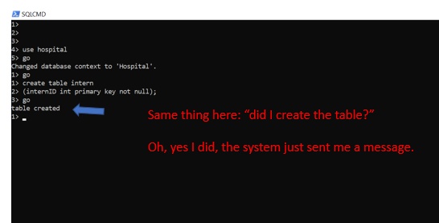

Slide 22
Triggers lessons
These are hard to learn, can be hard to trace through the system.
Syntax heavy, rigid, can block operations and slow down performance.
Very advanced, very complex.
Highly situational (DDL vs DML)
Usually done by DBA or admin, sometimes developer depending on permissions and roles.
Reason is you need certain permission levels depending on level of trigger and event.
Very dangerous, so use with caution, and experiment with dummy data a lot!
You can do really cool things with them like prevent accidents/mistakes such as drops, deletes, updates and modifications.
Roles don’t always prevent mistakes, when the action is within a role.

Slide 23
Table Level (DML) Trigger: Using “Instead of” to Prevent a Delete Operation
Table level trigger will prevent any row from being deleted.
Think of this as a try/catch.
create trigger dml_delete_bed
on bed
instead of delete
as
print 'you should never delete rows'
rollback
create trigger dml_delete_patient
on patient
instead of delete
as
print 'you should never delete rows'
rollback

Slide 24
Rules and Defaults
I like them a lot, because I think they are easier to apply than Check Constraints, but they are harder to track because they are DB level and not table level.
You can also bind them to customized User Data Types (if you remember that from Building Tables).
Most developers I talk with tell me they use Check (CK) as a primary constraint (CN) design.

Slide 25
What are Rules?
Constraints that apply INDEPENDENTLY to any one or more columns you “bind the rule” on one or more than one table.
Rules work like Checks in that they limit the type of values that can be inserted/updated.
Commands:
Exec sp_Create Rule
Exec sp_Bind Rule
Exec sp_HelpText Rule
Exec sp_Depends Rule
Exec sp_Unbind Rule
Exec sp_Drop Rule

Slide 26
Rules and Defaults, versus SPROCs
Rules and Defaults are different from SPROCs in that you “bind” them to specific columns on any table you like.
Example to try:
Create Rule StateRule
As @State Like '[A-Z][A-Z]';
Exec sp_bindrule StateRule, 'Patient.State’;
Exec sp_bindrule StateRule, 'Physician.State';
I had to add some more attributes to Physician, such as “state,” to make this practical.

Slide 27
Rule example for you to try out
Syntax:
Use Hospital
Create Rule HoursRule
As @Hours > 2;
Exec sp_bindrule HoursRule, 'Assignment.Hours';
Exec sp_unbindrule 'Assignment.hours';
Drop rule HoursRule

Slide 28
Rules versus Checks (CK)
One thing I don’t like is that I can’t quickly tell by looking at my table design, what column or columns the rule is bound.
So there is another command for that:
Syntax: - What is that rule again?
- Where did I bind it?
exec sp_helptext StateRule
exec sp_depends StateRule

Slide 29
The lesson to know about Rules
Why do I want to use it instead of check constraint?
Well, if I know I will reuse it on other tables, than I can treat a “constraint” like a Sproc really.
Also, remember User Defined Data Type

Slide 30
Defaults versus Rules
Not like a CK constraint in a column. It inserts a pre-set value.
Implemented like a Rule. You can create it, bind it, reuse it.
Syntax:
create default SpecialtyDefault
As 'N/A';
Compare
Create Rule StateRule
As @State Like '[A-Z][A-Z]';
Biggest advantage comes when performing boring data entry.
For example, if everyone is from Florida, you can default state to ‘FL.’
Or when you are entering ‘dummy data’ – think default for phone, zip, email.
Another tool for reducing data entry errors.

Slide 31
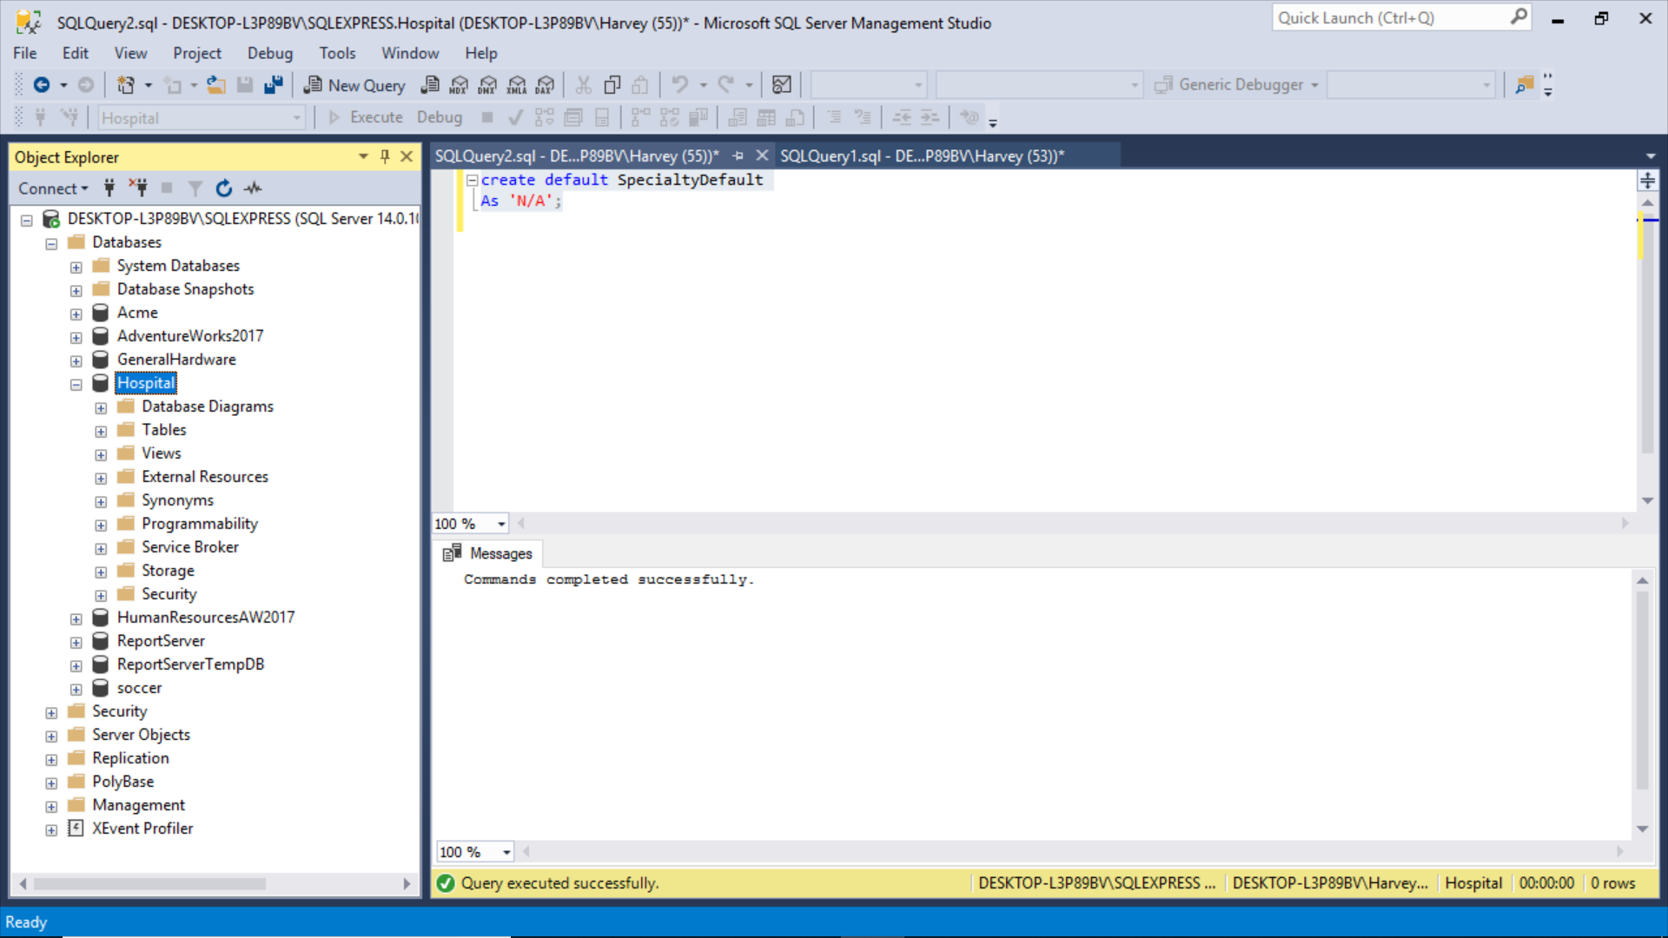

Slide 32
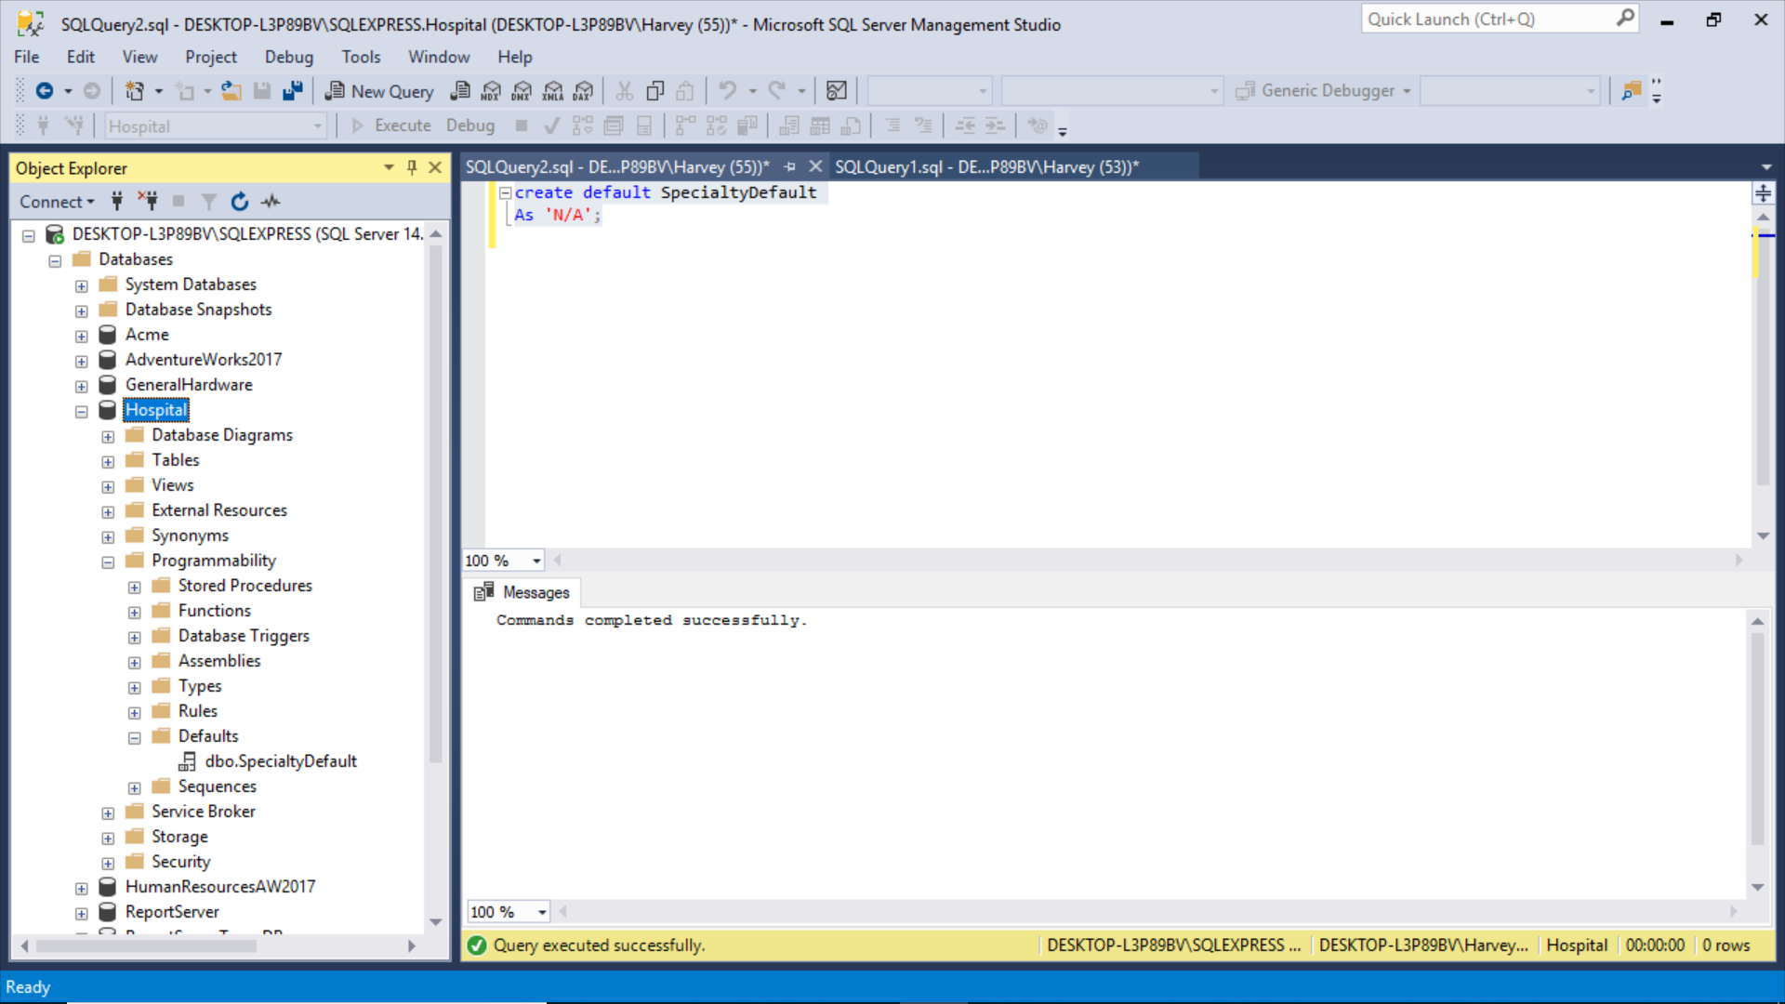
Create a default for specialty

Slide 33
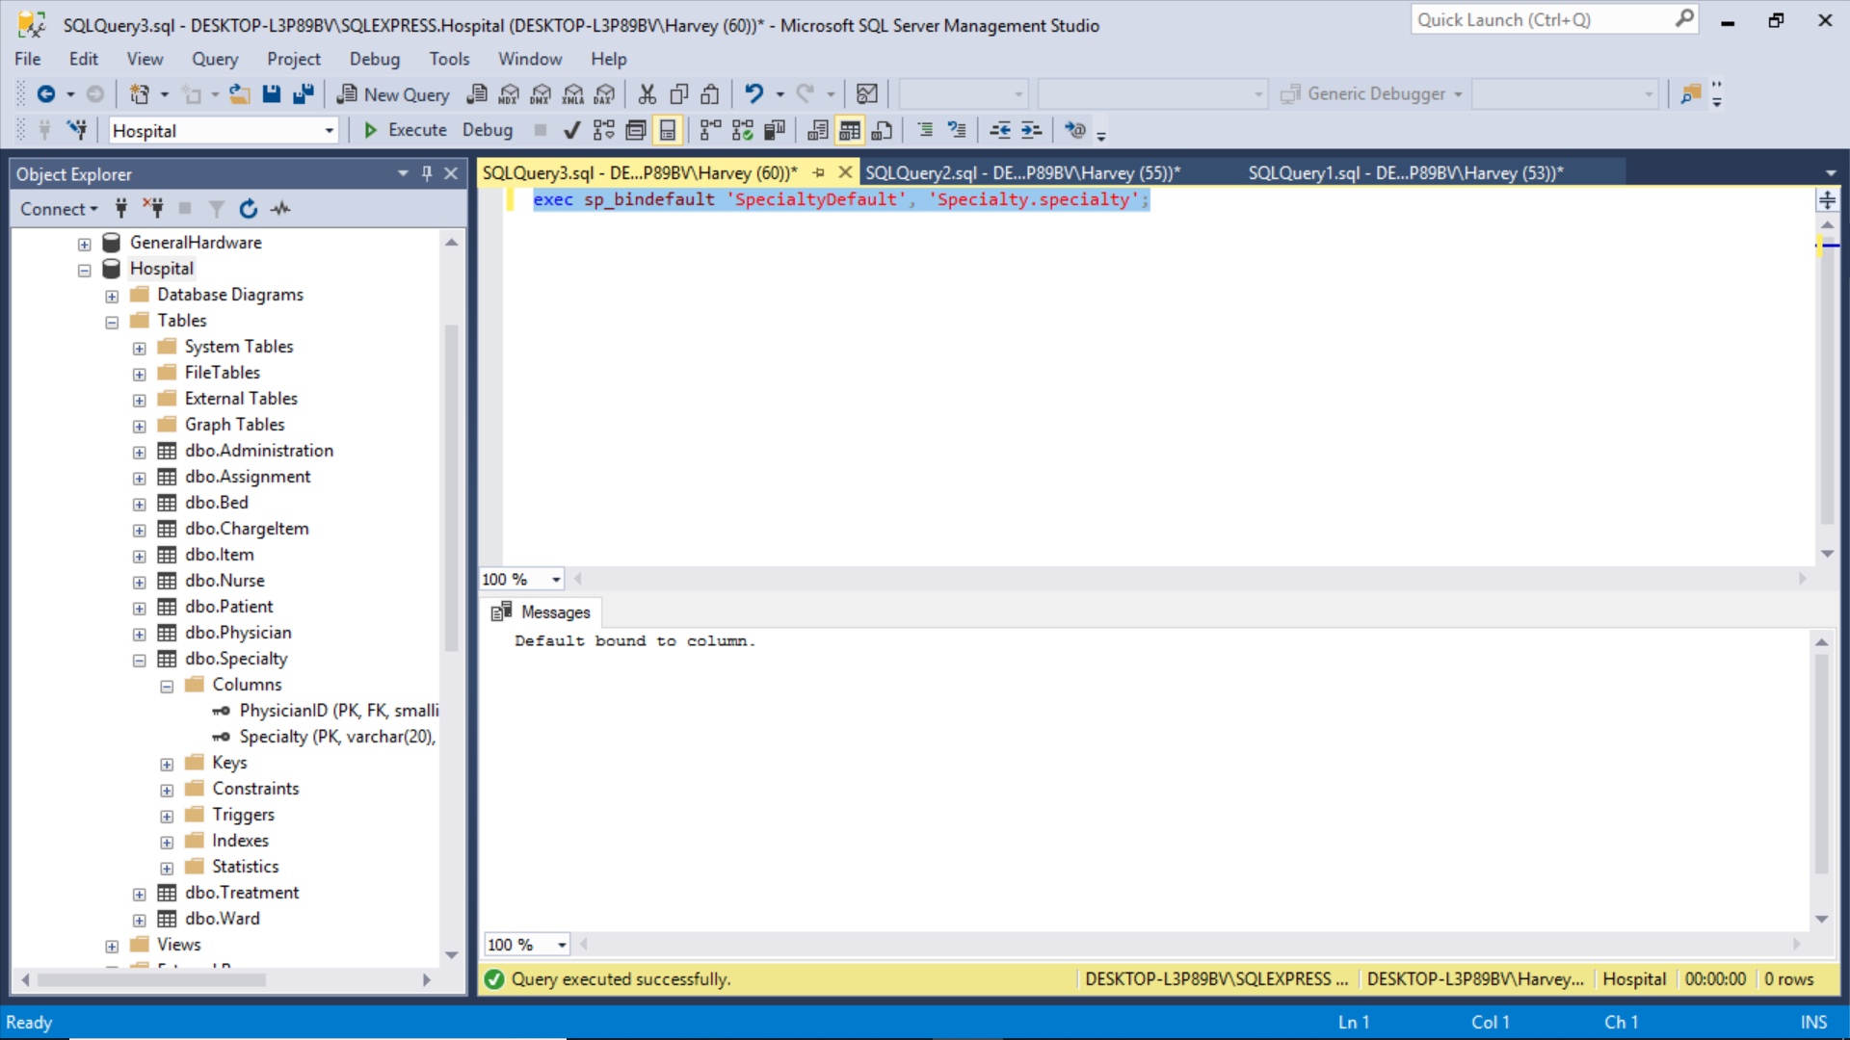
Now let’s bind it to the column

Slide 34
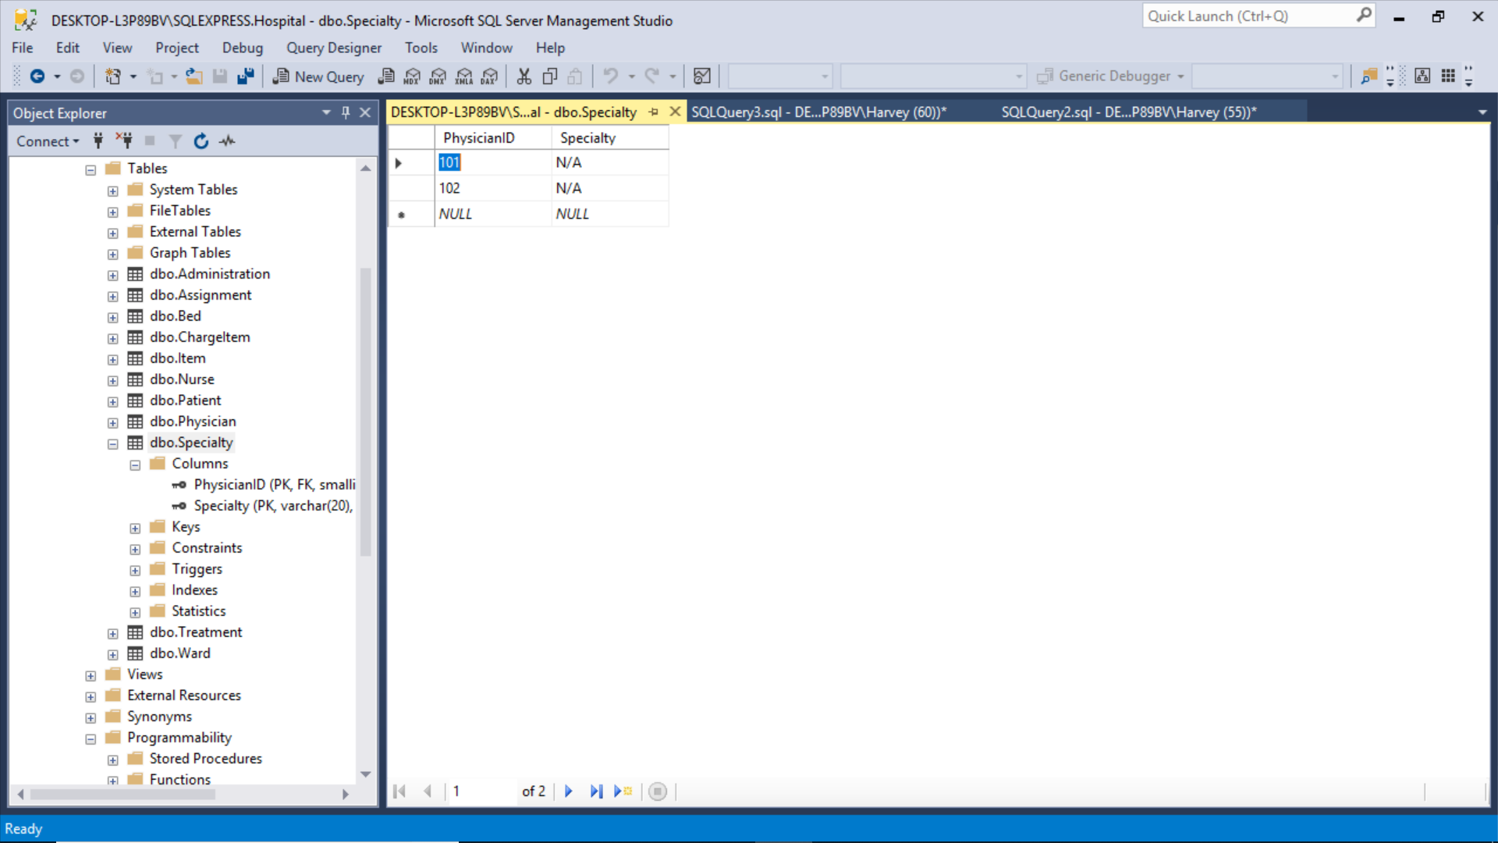
And, Bob’s your uncle!

Slide 35
Advanced Rules and Defaults Using them as Constraints for User Defined Data Types

Slide 36
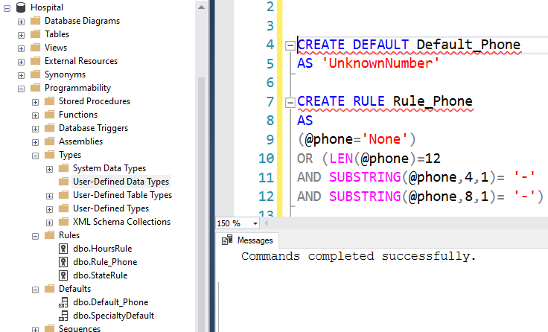
Syntax Code and SSMS Navigation
CREATE DEFAULT Default_Phone
AS 'UnknownNumber'
CREATE RULE Rule_Phone
AS
(@phone='None')
OR (LEN(@phone)=12
AND SUBSTRING(@phone,4,1)= '-'
AND SUBSTRING(@phone,8,1)= '-')
-- bind to user defined data type 'Phone'
EXEC sp_bindefault 'Default_Phone', 'Phone'
EXEC sp_bindrule 'rule_Phone', 'Phone'

Slide 37
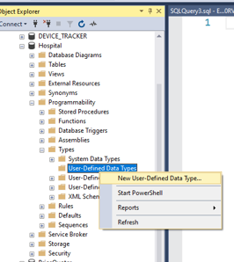
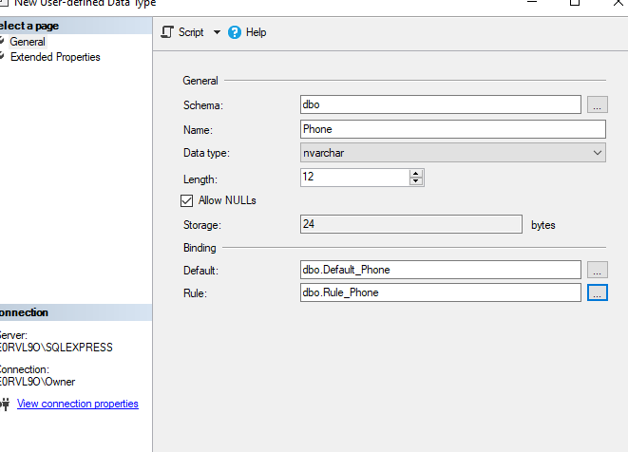
Create a User Defined Data Type Select Binding of Rule or a Default to the Data Type

Slide 38
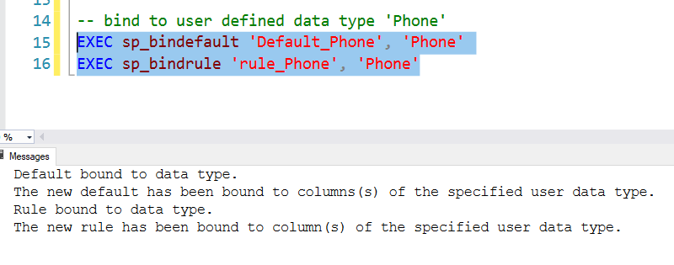
Bind Rule or Default to Data Type

Slide 39
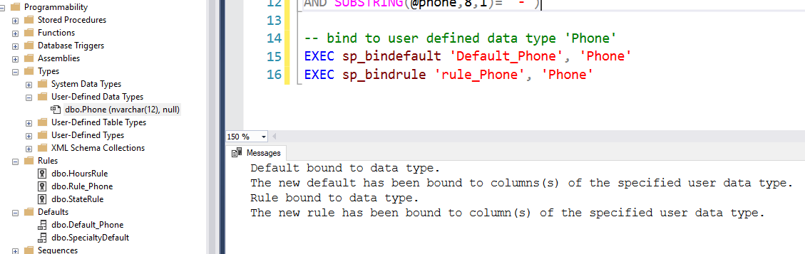
And, Bob is your uncle!

Slide 40
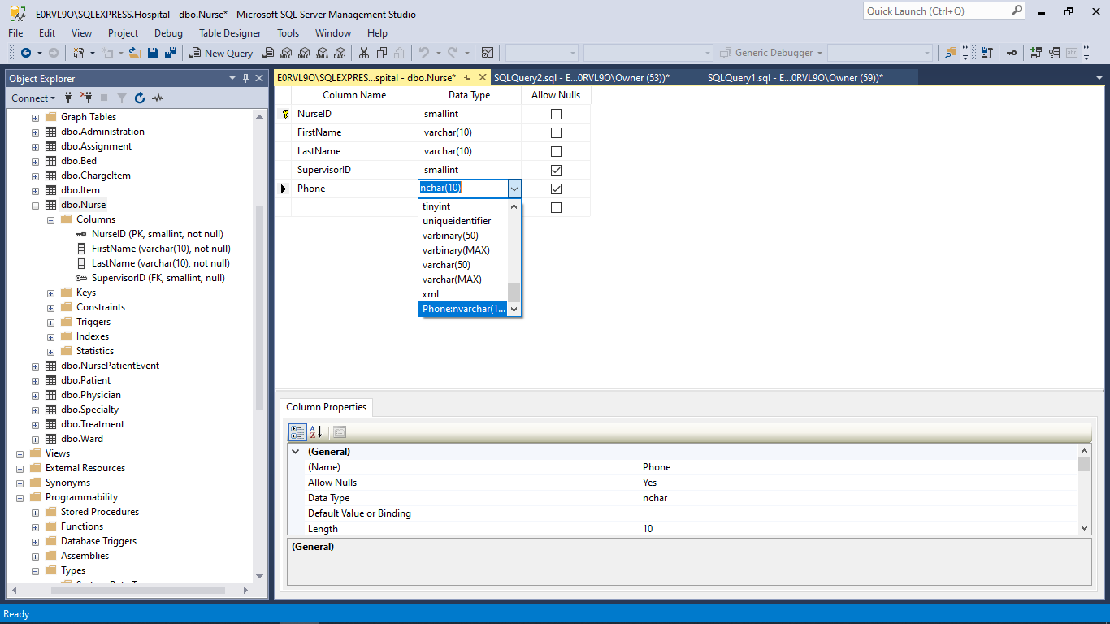
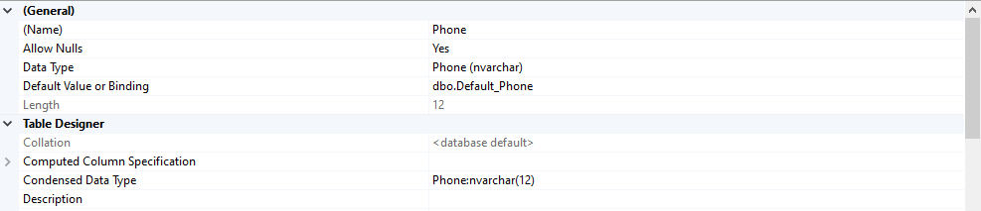
Here is how you use it

